Slide 1

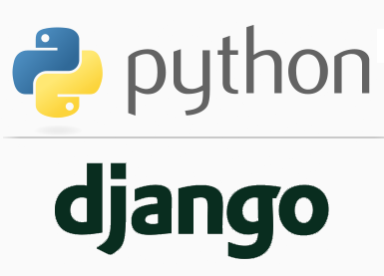
FULL STACK WEB DEVELOPMENT WITH DJANGO
Lecture 23

Slide 2

Today’s Agenda
Developing Our Django App
Using Django Interactive Shell
Examples

Slide 3
Using Django Interactive Shell
Before moving any further in working with models , we ’re going to be using the Django interactive shell.
Django’s interactive shell runs just like the regular Python interactive shell, except it loads our project’s settings module and other Django-specific modules, so we can work directly with our Django project.
To use the Django interactive shell, we must first be running the virtual environment, and then run the following command from inside django project folder:
python manage.py shell

Slide 4
Using Django Interactive Shell
Load the previous project folder in VS Code
Launch the virtual environment and open the command prompt window
Now go to the django project folder and run the following command:
python manage.py shell

Slide 5
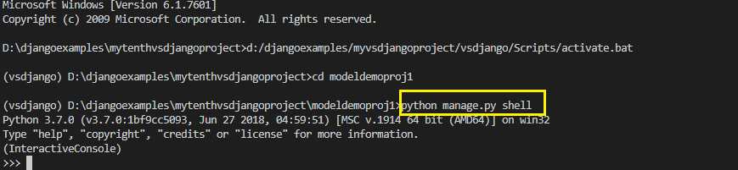
Using Django Interactive Shell
The terminal output should look like this:

Slide 6
Inserting Records Using Django Interactive Shell
To insert a new book to the database from the Django console we follow 3 steps:
Import the Book model
Create a Book object
Call the save() method

Slide 7
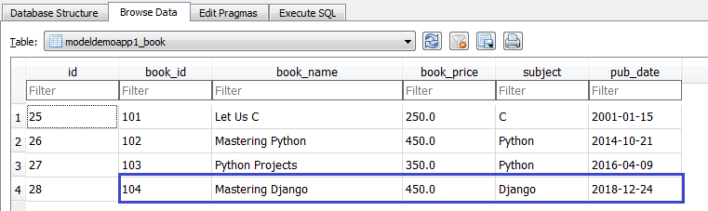
Inserting Records Using Django Interactive Shell
In the Django Interactive Shell , type the following code:
This will save a new record in the table and we can verify this by opening the database in sqlite browser:

Slide 8
Retrieving Records Using Django Interactive Shell
The Manager class
Before we can understand how to retrieve records , we must understand about the Manager class.
A Manager is the interface through which database query operations are provided to Django models.

Slide 9
Retrieving Records Using Django Interactive Shell
The Manager class
At least one Manager exists for every model in a Django application whose name by default is objects
All the methods that we call using objects like all(), get(), filter() etc belong to the Manager class

Slide 10
Retrieving Records Using Django Interactive Shell
Retrieve All Records
To retrieve all of the records in a database table, we use the all() method:
As we can see, this is not a very useful output – we have no way of knowing which book a ‘Book Object’ is referring to.
To overcome this problem we must override the method __str__() in our Book model class.

Slide 11
Retrieving Records Using Django Interactive Shell
Let’s go back to the Book model class definition and override the method __str__():
models.py
from django.db import models
class Book(models.Model):
book_id=models.IntegerField()
book_name=models.TextField()
book_price=models.FloatField()
subject=models.CharField(max_length=30)
pub_date=models.DateField()
def __str__(self):
return self.book_name

Slide 12
Retrieving Records Using Django Interactive Shell
The __str__() method generates a string representation of any Python object.
For the Book model, we are simply returning the name of the book.
We will have to close and restart the terminal for the changes to take effect, but after we have added the __str__() method, our terminal output should look like same as shown in the next slide

Slide 13

Retrieving Records Using Django Interactive Shell

Slide 14

Retrieving Single Record Using Django Interactive Shell
Retrieve A Single Record
We retrieve single records with the get() method by simply passing any field name and value as keyword argument based upon which the record should be selected

Slide 15
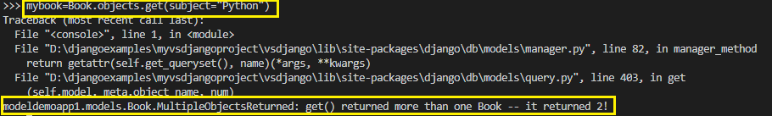
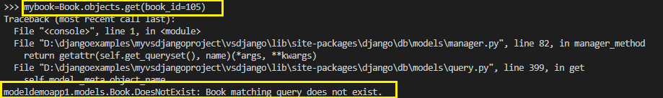
Retrieving Single Record Using Django Interactive Shell
However, the get() method only works for single objects. If our search term returns multiple records, we will get an error:
And if we try to retrieve a record that doesn’t exist, then also Django will throw a DoesNotExist error:

Slide 16

Retrieving Multiple Record Using Django Interactive Shell
Retrieving Multiple Records
Whereas the get() method is limited to returning a single record, the filter() method allows us to filter our data to return zero or more records.
We can filter with a single search term:

Slide 17
What Is QuerySet ?
The QuerySet Class
In all previous examples , we can observe that the methods all() and filter() returned us something called QuerySet.
QuerySet is a class in Django .
It represents a collection of objects from our database.

Slide 18
What Is QuerySet ?
The QuerySet Class
It can have zero, one or many filters.
Filters narrow down the query results based on the given parameters.
So the methods like filter() perform this kind of filtering and then return us the filtered QuerySet

Slide 19
What Is QuerySet ?
The QuerySet Class
If we want to view the query that Django executed for generating a QuerySet object , then we can access the query attribute of the QuerySet object as shown below:
Example:
book_list=Book.objects.all()
print(book_list.query)
Output

Slide 20
Retrieving Multiple Record Using Django Interactive Shell
We can also filter with multiple search terms:
In both the examples of filter() , Django translates the search terms into an SQL WHERE clause.

Slide 21
Retrieving Multiple Record Using Django Interactive Shell
To filter using logical OR operator we can use | symbol between 2 filter operations:

Slide 22
Retrieving Multiple Record Using Django Interactive Shell
By default, the filter() method uses exact match lookups.
For more control, we can search using one of Django’s field lookups.

Slide 23
Retrieving Multiple Record Using Django Interactive Shell
For example, we can search for all the books whose name contains the word “Mastering” in the following way:
Note that there’s a double underscore between book_name and contains.
The __contains part gets translated by Django into an SQL LIKE statement

Slide 24
Retrieving Multiple Record Using Django Interactive Shell
Some other important field look ups are:
icontains : Case-insensitive containment test.
Eg: Book.objects.filter(subject__icontains=‘Java’)
in: Search a value in a given list
Eg: Book.objects.filter(subject__in=[‘Java’, ‘Python’])
gt: Greater than
Eg: Book.objects.filter(book_price__gt=400)
gte, lt , lte
startswith,istartswith,endswith,iendswith
Eg: Book.objects.filter(subject__startswith=‘C’)

Slide 25
Retrieving Multiple Record Using Django Interactive Shell
range : Range Test
Eg:
import datetime
start_date = datetime.date(2005, 1, 1)
end_date = datetime.date(2005, 3, 31)
Book.objects.filter(pub_date__range=(start_date, end_date))
We can use range anywhere we can use BETWEEN in SQL — for dates, numbers and even characters.
date: Used for datetime fields
Eg:
Book.objects.filter(pub_date__date=datetime.date(2005, 1, 1)) Book.objects.filter(pub_date__date__gt=datetime.date(2005, 1, 1))
year: An exact year match
Eg: Book.objects.filter(pub_date__year=2005)
day,month,week,week_day

Slide 26
Retrieving Multiple Record Using Django Interactive Shell
isnull : Takes either True or False, which correspond to SQL queries of IS NULL and IS NOT NULL, respectively.
Eg:
Book.objects.filter(pub_date__isnull=True)

Slide 27

Two Important Points About filter()
If the search string doesn’t match, filter() will return an empty QuerySet:
If we want to fetch all records in the database table with filter( ), we must leave the query string blank:

Slide 28
Ordering Data
Retrieve Data In Sorted Order
We may notice from the previous examples that records are being retrieved from the database in table order.
If we want to sort the records by a field in the table, we use the order_by() method:

Slide 29
Ordering Data
Retrieve Data In Descending Order
If we want to sort in descending order, we add a minus (-) sign before the field name:

Slide 30
Ordering Data
Sorting On Multiple Fields
We can also sort by multiple fields:

Slide 31

Chaining Lookups
Using multiple methods
It’s very common to want to set a sort order on a subset of our database records.
We achieve this in Django by chaining lookups.
In this example, the filter() method first retrieves all books of Python and then the order_by() method sorts them in ascending order of book_price

Slide 32
Slicing Data
Getting Partial Data
We can also access a single QuerySet element by using subscript operator
This is handy when we want to access only a particular record
For example, we can retrieve the first published book:

Slide 33
Slicing Data
Getting Partial Data
We can also return a fixed number of rows from the database using Python’s list slicing syntax.
This is handy when we are paginating data, or want to return only Top 10 of a QuerySet.
For example, we can retrieve only the first 3 book names:

Slide 34
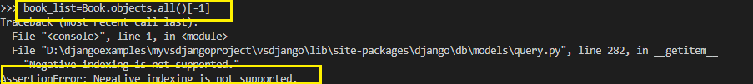
Slicing Data
Getting Partial Data
What we can’t do is use negative indexing. So, this won’t work:

Slide 35
Updating Records
If we have a reference to a model record, an update is as simple as updating it’s attributes using Python's dotted notation and then calling the save() method on it.

Slide 36
Updating Records
For example , to update the price of the book Let Us C to 400 , we need to do 3 steps:
Get the Book object pertaining to Let Us C
Update the book_price field by assigning it 400
Save the changes to the database by calling the method save()

Slide 37
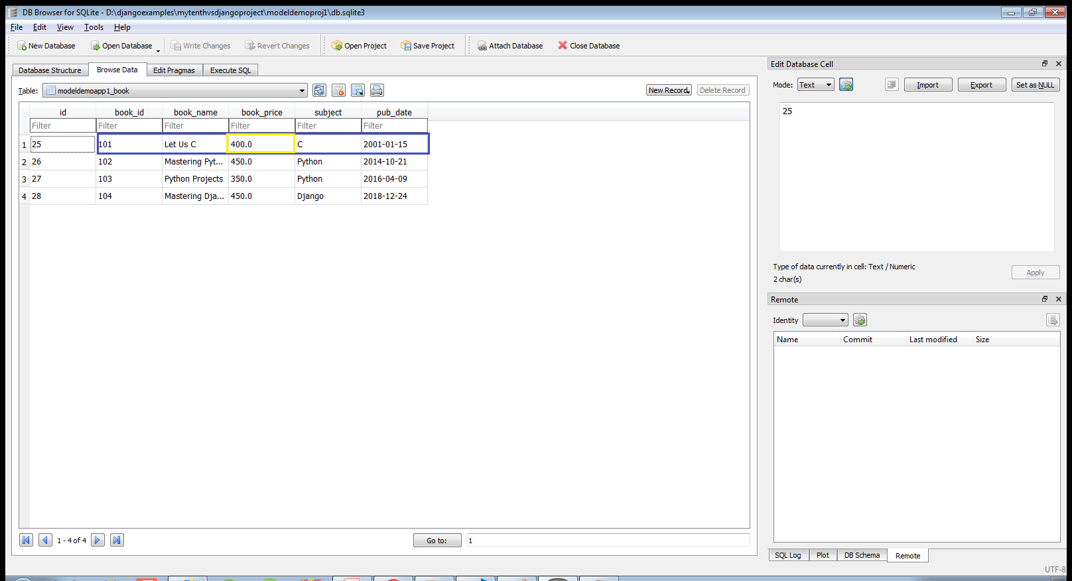
Updating Records
We can verify that changes have been done by checking the database table in sqlite browser

Slide 38
Updating Records
While this method of updating a database record is straight forward, it’s inefficient as it will save all the field values, not just the book_price.
To ensure records are updated in the most efficient manner possible, we should use the update() method.

Slide 39
Updating Records
This method belongs to QuerySet object and it accepts the field name and value as keyword argument , updates the record and returns an integer indicating how many rows have been updated.

Slide 40
Updating Records
We can also update multiple fields by passing them as keyword argument.
For example to set the book_price and subject to 400 and C lang for the book Let Us C ,our code would be:

Slide 41
Deleting Records
We can delete a record in 2 ways:
By fetching an individual record from the database and calling the method delete() on our model object
By fetching an individual record from the database and calling the method delete() on QuerySet

Slide 42

Deleting Records
For example , to delete the book Let Us C , using the first approach , our code will be
The return value for the delete() method lists the total number of records affected (one in this example) and a dictionary listing all the tables that will be affected by the delete operation and the number of records deleted in each table.

Slide 43
Deleting Records
To delete all the books whose price is greater than 400 our code will be
To delete all the records from the table our code will be

